Slide 1

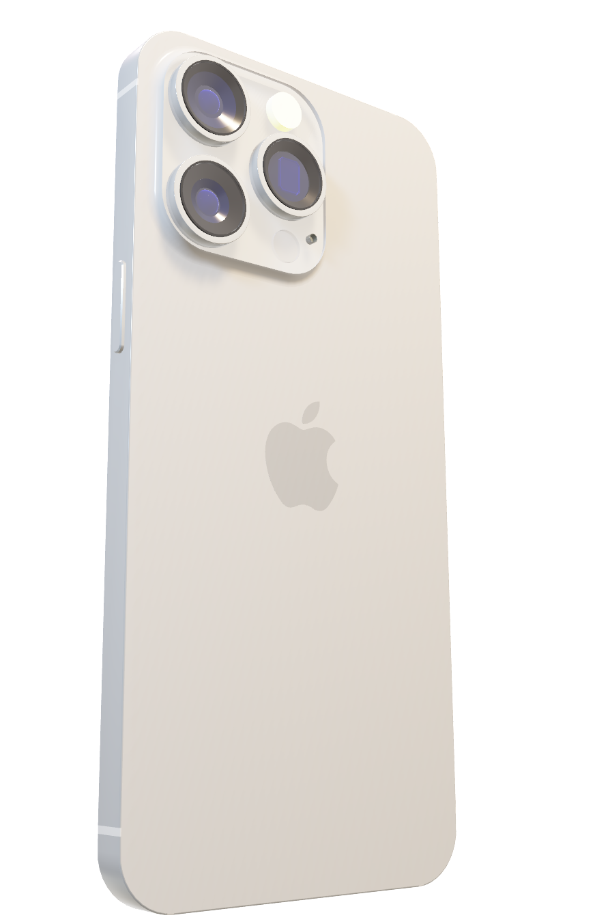

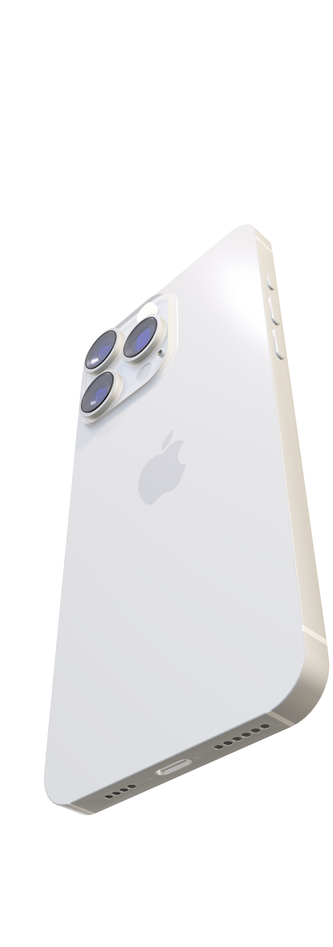

- Surge in Shipments
: 52% increase in April compared to 12% in March
- Competitive Positioning
- Anticipation of future
price drops
- Impact sales in
non- promotional period
From Premium to Practical
Apple Slashes iPhone Prices in China
Apple’s Pricing Strategy – Premium/Skimming Strategy
Apple’s Pricing Strategy in China
Aggressive Price Cuts on select iPhone Models
Reason for Discount Strategy
- Weak economy: Price-sensitive consumers
- Promotional Period: “618” Shopping Festival
- Local manufacturers: Huawei & Xiaomi

Slide 2




How can Apple ensure its brand equity is not compromised by strategies such as discount strategy employed in markets like China?
From Premium to Practical
Apple Slashes iPhone Prices in China
- Surge in Shipments
: 52% increase in April compared to 12% in March
- Competitive Positioning
- Anticipation of future
price drops
- Impact sales in
non- promotional period
Apple’s Pricing Strategy – Premium/Skimming Strategy
Apple’s Pricing Strategy in China
Aggressive Price Cuts on select iPhone Models
Reason for Discount Strategy
- Weak economy: Price-sensitive consumers
- Promotional Period: “618” Shopping Festival
- Local manufacturers: Huawei & Xiaomi

Slide 3



- Tailor to market conditions
- Emphasis on time-limited discounts
- Discount strategy does not imply a reduction in quality,
rather makes the premium quality product more
accessible.
From Premium to Practical
Apple Slashes iPhone Prices in China
- Surge in Shipments
: 52% increase in April compared to 12% in March
- Competitive Positioning
- Anticipation of future
price drops
- Impact sales in
non- promotional period
Apple’s Pricing Strategy – Premium/Skimming Strategy
Apple’s Pricing Strategy in China
Aggressive Price Cuts on select iPhone Models
Reason for Discount Strategy
- Weak economy: Price-sensitive consumers
- Promotional Period: “618” Shopping Festival
- Local manufacturers: Huawei & Xiaomi
How can Apple ensure its brand equity is not compromised by strategies such as discount strategy employed in markets like China?

